Slide 1
Student Experience Redesign – First Year Initiation Update Undergraduate Council May 22, 2019

Slide 2
Core Elements of
Student Experience Redesign
Mason Student Services Center
Student Portal
Coaching & Advising
Lifecycle CRM*
Mason Initiation
Culture of Service
*Banner-related changes and implementations included as part of Lifecycle CRM roadmap.

Slide 3
Mason Initiation
Established Three Teams:
First-Year Seminars- To pilot a blended course delivery and peer mentorship model that supports first-time, full-time students throughout their first year
New Student Programming- To streamline orientation and reposition programming during a week-long welcome program to deepen student learning and educate them about resources just-in-time.
First-Year Communication- To bring many campus stakeholders together to discuss potential challenges around streamlined communication to new students.
Created First-Year Student Learning Outcomes:
As a result of their first year at Mason students will...
Identify their academic, personal, and career interests and a have plan to further explore them.
Build a supportive network of peers, faculty, and staff.
Engage in involvement opportunities with people, cultures, and ideas different from their own.
Develop a sense of civility and responsibility as an engaged citizen and a member of the Mason community.
Utilize campus resources and systems that support their success at Mason.

Slide 4
First-Year Seminars
Primary Deliverable-
Provide a full year experience for first-year students through First-Year Seminar experience (UNIV 100 & UNIV101)
Updates-
Developed New Student Learning Outcomes
Enhanced training for faculty and Peer Advisors (PAs)
Additional programming in spring for fall UNIV100 students, faculty, PAs
Creation of UNIV101 course
Expansion of UNIV100 topics and exploration of experiential learning opportunities
Mason Impact
Leadership Opportunities
Jobs & Internships
Next Steps-
Team leads will be attending AAC&U High Impact Practices Institute in June
Complete UNIV101 Student Learning Outcomes
Figure out the best way to share UNIV100 information to students who have not taken the course

Slide 5
New Student Programming
​
Updates- ​
Revisited the Orientation and program learning outcomes
The Preamble program is expanding one day with new student move-in taking place on Wednesday, August 21st with the addition of intentional programming​
Pilot two Quill Camp extended orientation programs this July ​
Camp Republic
Camp Vision​
Next Steps- ​
Implement changes to outcomes in 2020 first year programs​
Create initiation maps for special populations​
First-Year Advisory Board for continued collaboration and coordination​
Preamble 2019:
Wed Aug 21​ | Thu Aug 22​ | Fri Aug 23​ | Sat Aug 23​
Move In​ Family Farewell​ Club 4400​ | Cultural Inclusion​ Title IX Awareness​ Pep Rally​ Well-Being/ Recreation Carnival​ | Class photo​ Convocation & Picnic​ Campus Hunts​ Mason Mayhem | Movie Night​ Transfer Happy Hour​ Mason Block Party
Outcome Review:
Build a supportive network of peers, faculty and staff.
Orientation & Preamble​ | Quill Camp​ | Welcome2Mason​
Be able to identify at least two individuals at Mason with whom they formed a connection.​ | Build relationships with peers, faculty, and staff through shared passions interests. ​ | Students will be able to develop a meaningful connection with at least one new peer individual during ​ the course of Welcome2Mason. ​ ​

Slide 6
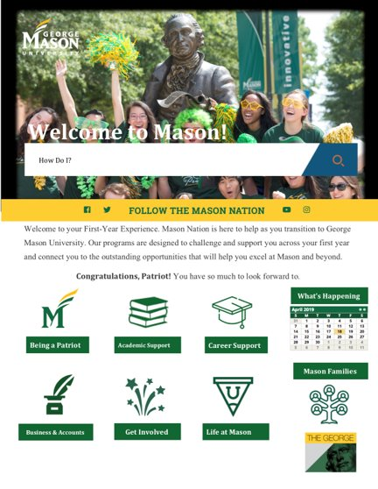
First-Year Communication
Updates- ​
Created a master list of required and recommended actions & experiences for first-year students​
Documented communication method recommendations and best practices in preparation of New Student Communication Coordinator position​
Outlined first year website content & design​
​
Next Steps- ​
Continue to gather data of what is being communicated to first-year students​
Create communication plans for first-year special populations​
Establish a first-year student website​
Mock Up of Recommended Activities/Things to Do
Mock Up of First-Year Website

Slide 7
Questions/Comments?
How can we engage faculty and staff from the colleges/academic departments?
What opportunities or challenges do you foresee?

