Slide 2
College of Education and Human Development
School
of Education
School of Sport, Recreation, & Tourism Management
School of
Kinesiology
Office of Doctoral Studies
The College Structure
3 Programs
SMART Lab
7 Divisions
20+ Programs
8 Centers
Mason LIFE Program
4 Programs
1 Center
≈ 1000 Undergraduate Students
≈ 2500 Graduate Students
300+ Faculty and Staff
Notes:
We are a fairly large College and unique in our structure. ​
​
Unlike most academic units, we have significantly more graduate students than undergraduates and all of our programs (or majors) are housed within one of our three schools. No departments, so the largest SOED has sub divisions in which common programs are included
SOED: BSED in ELED, ECDL, EDSE, PHED
SRTM: BS in SPMG, RMGT, TEM
SOK: BS in KINE
Minors (21): ASL, Sport Communication/Analytics/Diplomacy, Hospitality Mgt, and Ed Psych
School Directors, Division Directors, Academic Program Coordinators
​
​

Slide 3
SOED Curriculum Committee (5)
SRTM Curriculum Committee (3)
SOK Curriculum Committee (3)
Ex Officio: Associate Dean
Attendees: Accreditation; External Reporting; Academic Affairs Coordinator; Program reps
Assist in development and management of a relevant and coordinated UG and GR curriculum
Review all new and modified curricular proposals and policy changes
Minutes distributed to CEHD
By-Laws
Standing Committees
Notes:
Curriculum begins with the faculty; ultimately processed by the Office of Student and Academic Affairs
Members elected by the faculty, two-year staggered terms; chair selected by the committee
Tone and tenor varies (some virtual with google drive, some zoom, some combo) - Common purposes
Conversations are robust; Meet at least once per month
Invite Accreditation, External Reporting, Licensure, Academic Affairs Coordinator (Julia Adams), faculty
Minutes are distributed to all CEHD faculty and staff – complementary programs, this provides time for comment pre-preparation for GC, UGC, or Mason Core
Once through UGC or Mason Core, share the outcomes of meetings in The 2200 (weekly e-digest for faculty/staff) with highlights in student edition

Slide 4
Academic Affairs | CEHD (gmu.edu)
Online and Standard Syllabus Templates
Curriculum Development
Processes
SCHEV
SACS
Syllabi Review
Curriculum Development
Resources
Notes:
Cehd.gmu.edu/saa/academic-affairs (one stop shop)
Pride in our syllabi and the intent and development/modifications of our curricula (iterative feedback)
Varied resources, including guides to review curricula, syllabi templates and review process and timelines
Online and Standard Syllabus Templates: updated annually. If new or revised course, must use new template; otherwise, changes emailed to all faculty to, in turn, communicate to students and embed in syllabi moving forward (e.g., change in Mandatory Reporting with addition of Sexual Harassment and terminology as Non-Confidential employees).
​Not unlike graduation, this (UGC) isn’t always the end: it’s only the beginning. I coordinate with Susan Woodruff and Matt Smith to navigate SCHEV and SACS.
Currently and still “down” our Assistant Dean for AA.

Slide 5
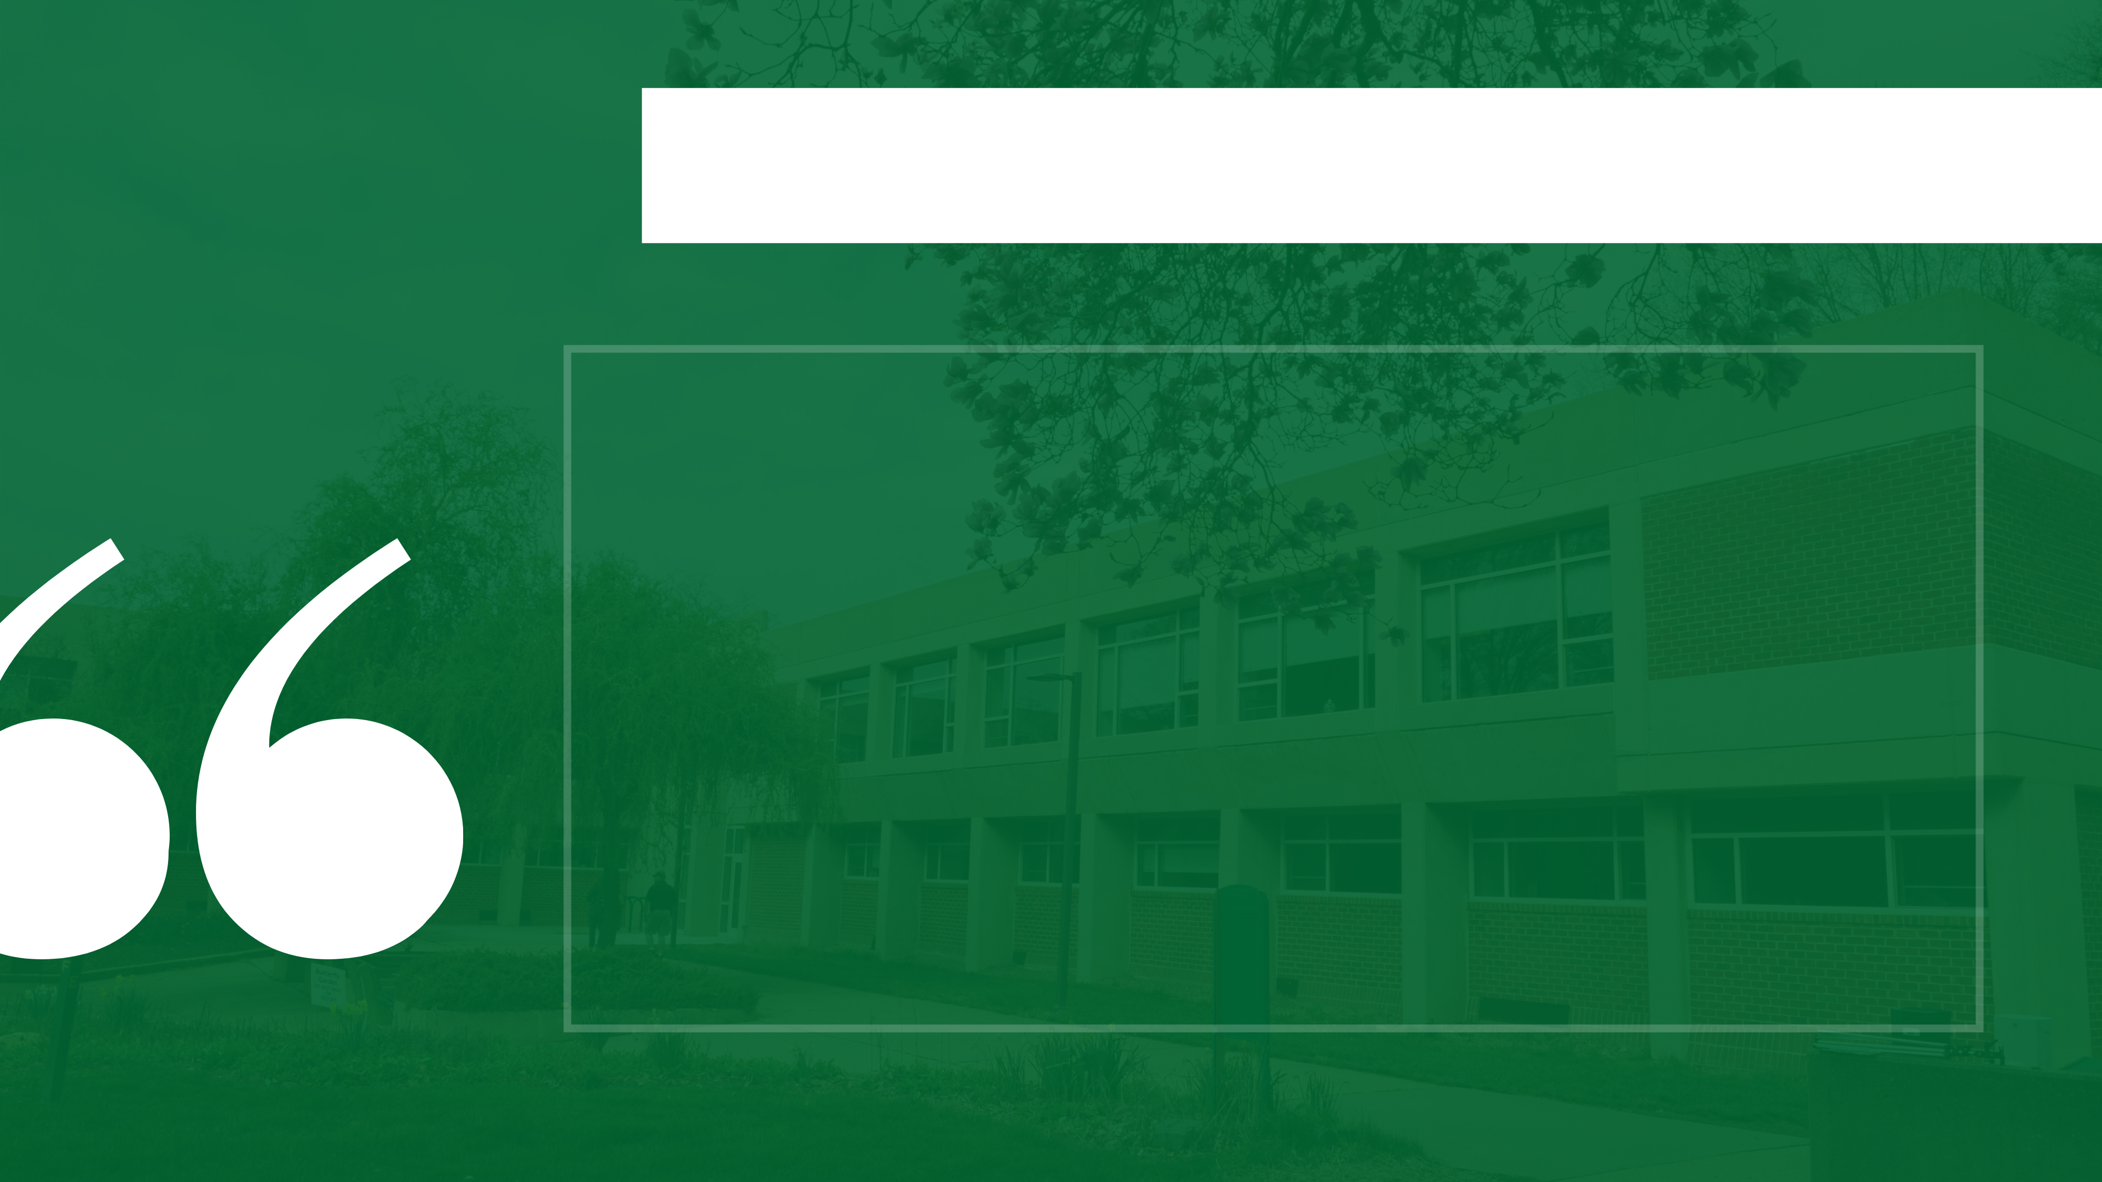
The CEHD Student Success Formula
BE INFORMED.
BE ENGAGED.
BE PRESENT.
Notes:
Successful students learn as much outside the classroom as they do inside it. We want them to:
Orientations, The 2200, etc.
Being informed is about staying in the know. Don’t be a stranger in your own home! Know the rules. The student experience is governed by a set of policies and procedures that can be found in the University Catalog. Not knowing is not a well-received excuse on campus. There are policies for everything! ​
​
Just as the Catalog helps us to understand and navigate the University and the College, the class syllabus governs the individual class. The class syllabus informs the students of not only major assignments and deadlines but also the class attendance policy and grading. ​
​
We communicate with students through their Mason email. Check it daily! Don’t miss out on opportunities. They can be costly. ​
​
Read The 2200, a weekly e-news digest that tells students the happenings within the College and around campus, including events and important deadlines.​
​
Read/Subscribe to the Student Success Blog. Here’s where we share job opportunities, blog about topics of interests, and share success stories. You can subscribe too! ​

