Slide 1
Transformative Education through Anti-Racist Community Engagement George Mason University’s Quality Enhancement Plan

Slide 2
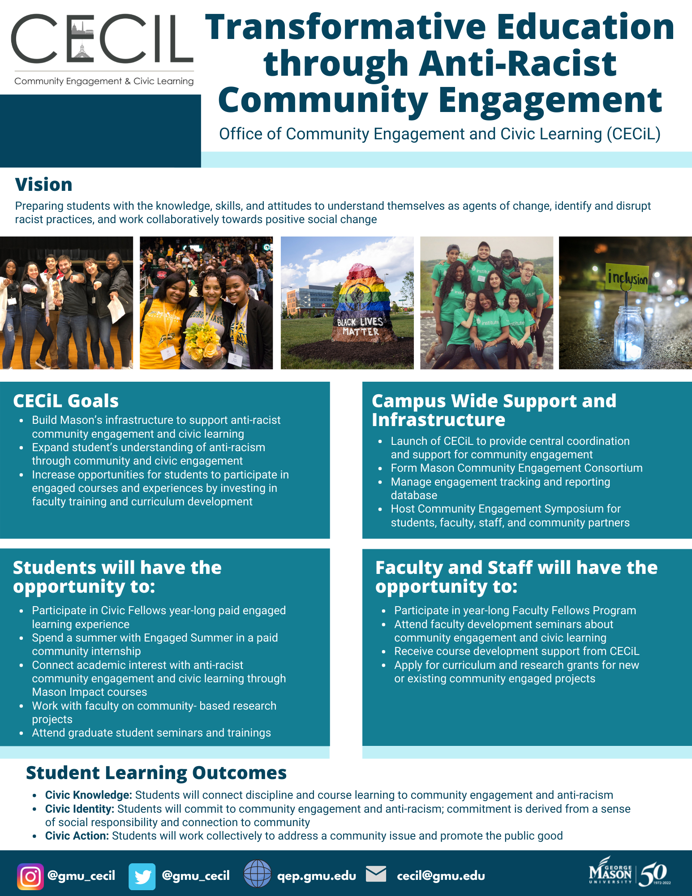
QEP Goal 1: Infrastructure Updates
SACSCOC On Site Visit Preparation
April 12 – 14
QEP One Pager- share with departments, colleagues, students
Outreach campaign via social media, newsletters
CECiL Hiring
Shauna Rigaud, Associate Director of CECiL
Cara Snider, Program Manager for Engaged Learning
CECiL Website- Launching soon
Community Engagement Consortium
Looking for School/College representatives
2
Notes:
Kristen

Slide 3
QEP Goal 2: Student Learning Updates
Civic Fellows Program to Launch Fall 2022
1 year paid community internship experience
Cohort model
Curriculum around community leadership, anti-racist community engagement, civic learning
Recruiting students
Developing Student Learning Modules Summer 2022
Graduate Student Appreciation Week Event
Thursday, March 31, 12 – 2pm: Fenwick Reading Room
Flier with more information
3
Notes:
Kristen

Slide 4
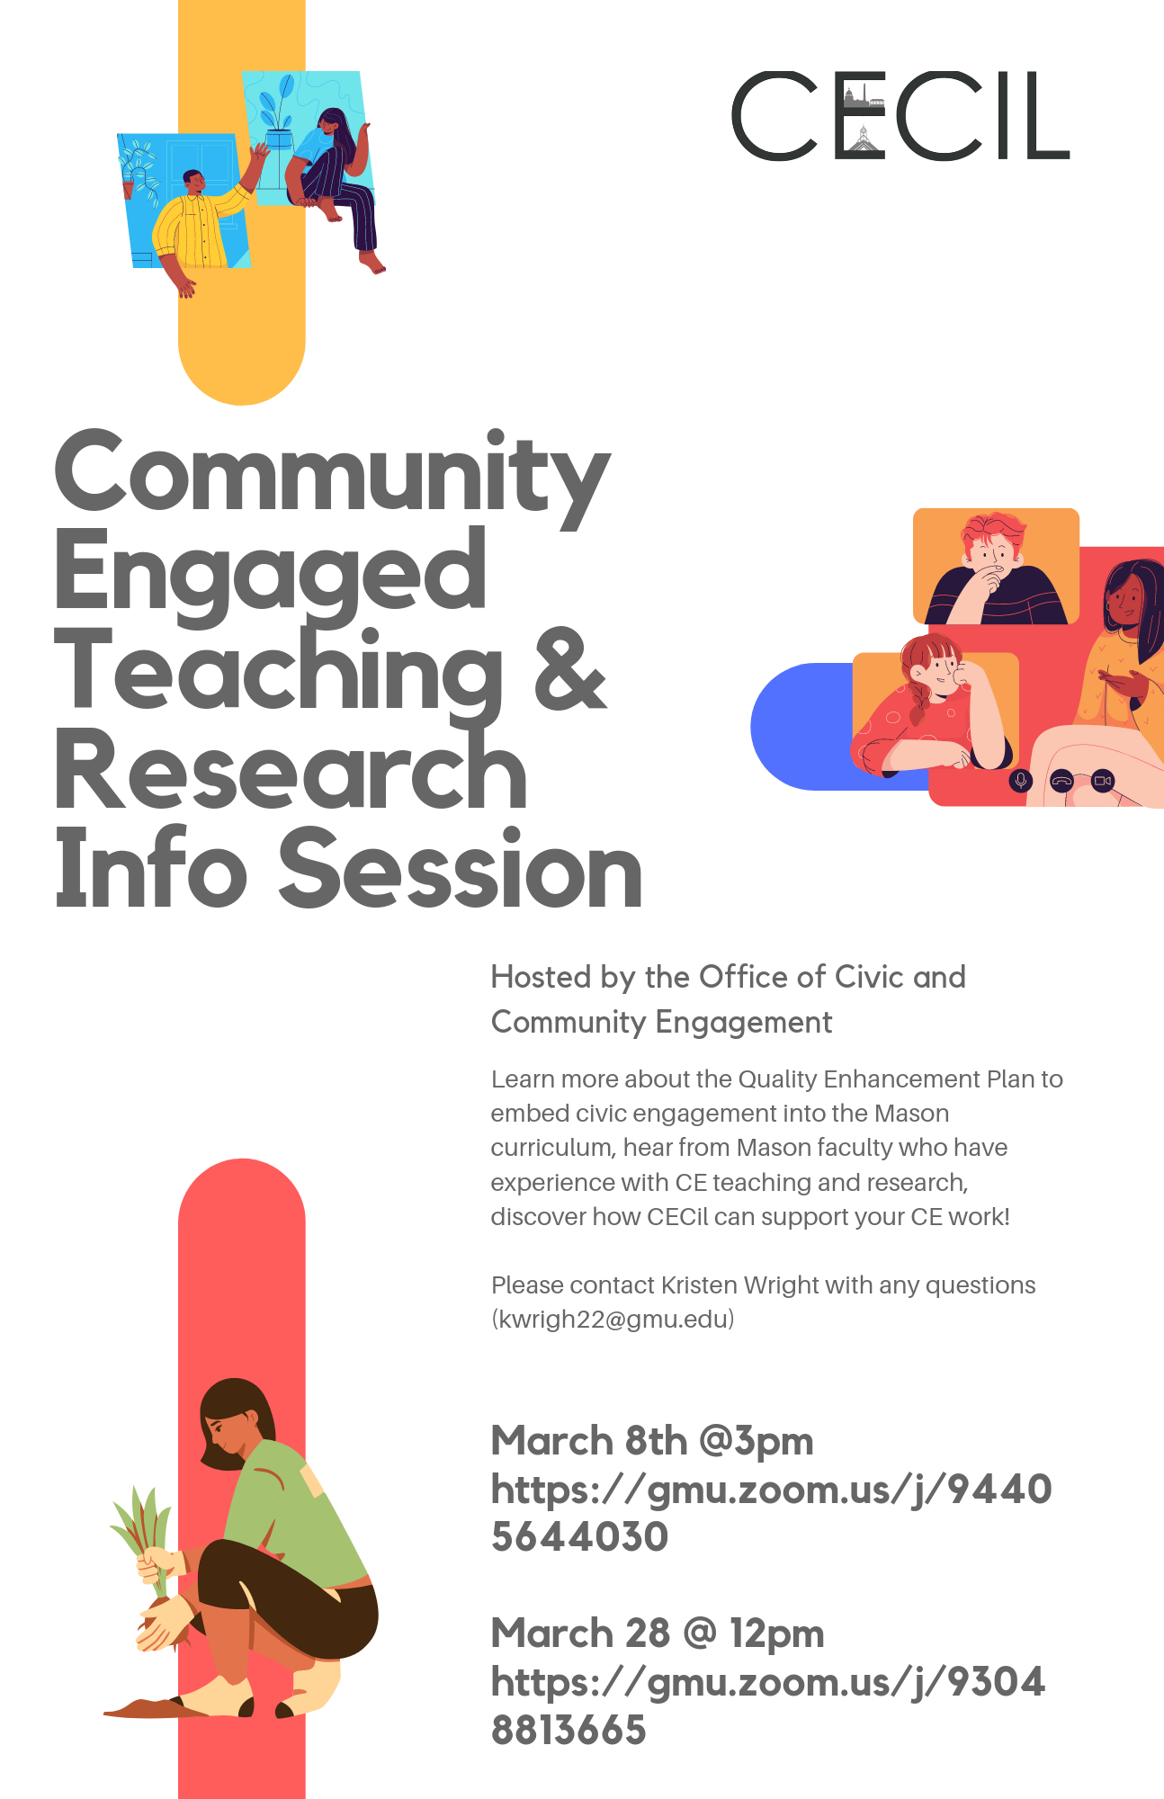
QEP Goal 2: Faculty Support Updates
Faculty Information Sessions
Monday, March 28th at 12pm via Zoom
Flier with more information
Recruiting for CECiL Faculty Fellows Program
Deadline to apply – May 3
Individuals or teams up to three faculty members may apply
More information in Overview handout
Curriculum Impact Grants
Seeking proposals that connect to QEP goals
Website and Database- Coming soon!
4
Notes:
Kristen

