Slide 1
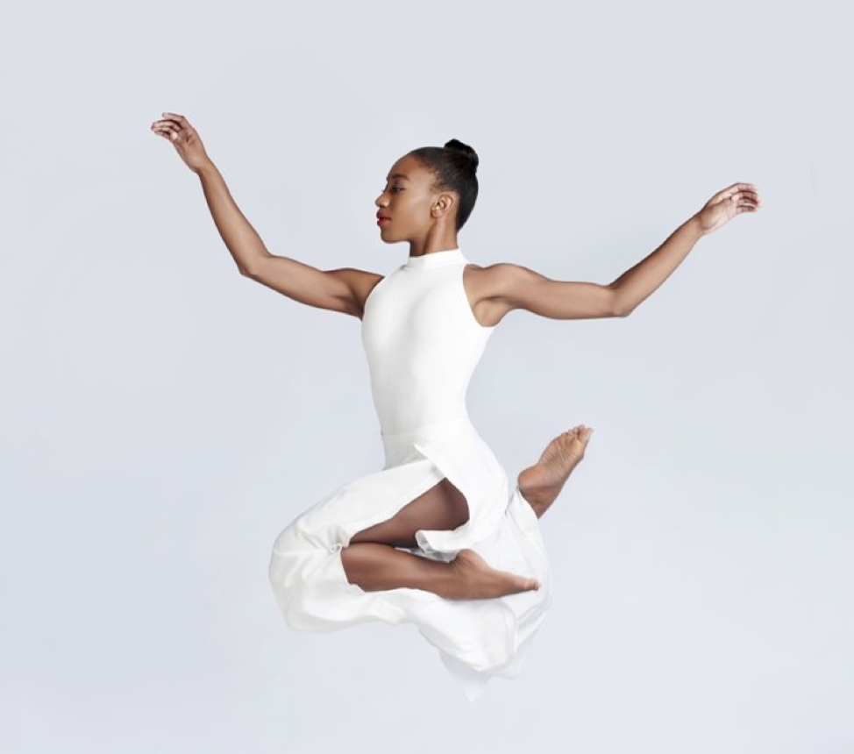
College Curriculum Process

Slide 2
CVPA Structure
THREE VISUAL ARTS SCHOOLS/UNITS
School of Art
Computer Game Design
UNDG and MK
Film and Video Studies - UNDG only
THREE PERFORMING ARTS SCHOOLS
School of Dance
School of Music
School of Theater
And Arts Management (GRAD)

Slide 3
Steps
Department level
Faculty or faculty committees propose new courses, new programs, or amendments to current catalog content
When necessary, faculty member connects with any other CVPA unit who could be impacted by the change for approval from that unit
Unit curriculum committee convenes monthly* to vote
Committee approves or rolls back to originating faculty for edits
Proposal is submitted into CIM
College level
CVPA Curriculum Committee members review CIM submissions individually prior to agenda deadline
Committee convenes monthly* to vote
Committee discusses, approves or rolls proposal back to originating unit

Slide 4
CVPA Curriculum Committee
7 voting members (1 per unit), named by the unit directors, 1-year term
Ex-officio members
2 representatives from CVPA Dean’s office (grad and undergrad)
Academic advisor from each unit
Meets monthly September through April
Chaired by a faculty member
Elected each year by the voting members of the committee

Slide 5
New and next
Re-think of Art and Visual Technology BA and BFA degrees
Removal of portfolio requirement
Renaming the School of Art & Design
Removal of student barriers and clarification of courses in GAME
More thoughtful design to Musical Theater
CVPA seminar course around arts advocacy and the social value of the arts
New Director of Diversity for the College, Shá Norman
Quill Camp (Studio) coming in August

Slide 6
FIN

