Slide 1
TimelyCare at Mason: Introducing a New Mental Health Resource for Students

Slide 2
TimelyCare | Mental Health + Well-Being
TalkNow
On-demand, mental and emotional support.
Scheduled Counseling
Appointments with diverse, credentialed, and licensed mental health professionals are available in less than 7 days.
Psychiatry
Students can access a licensed psychiatrist for a scheduled appointment in less than a week.
Digital Self-Care
Self-serve, well-being content designed to enhance a sense of calm, rest, and self-esteem both live and on-demand.
Health Coaching
Coaching to support lifestyle changes and developing healthy habits.
Faculty + Staff Support
A dedicated phone line for your to reach our care team for guidance in cases of student distress.
Notes:
TimelyCare is a virtual mental health and well-being platform available 24/7 for Mason students. Students can log in through URL provided or download the app on their phone. It is free for enrolled Mason students to access.
These are the services that will be provided through TimelyCare.
TalkNow is 24/7, on-demand emotional support to talk about anything, including anxiety, relationships, depression, and school-related stressors. Students can access this anywhere in the U.S. or overseas. They will not be able to choose their provider, but will meet with one that is available at that moment.
Scheduled Counseling: Choose the day, time, and a licensed mental health provider that works best for you. Students may choose from a list of licensed providers to schedule an appointment. They can schedule up to 12 appointments per academic year though it is case by case on if they need more support.
Health Coaching: Develop healthy lifestyle behaviors for nutrition, sleep habits, time management, and mindfulness.
Psychiatry: Appointments are available through referrals from CAPS and Student Health Services.
Self-Care Content: Visit the Explore page within TimelyCare for guided self-care content such as meditation and yoga.

Slide 3
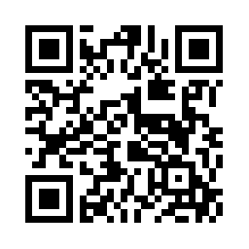
FREE 24/7 Virtual Mental Healthcare!
(Seriously, we really mean free.)
SCAN TO DOWNLOAD
First-year student tip #1:
Download the TimelyCare app!
TimelyCare offers FREE mental health services to students 24/7 from anywhere in the U.S. You read that right! FREE. No insurance needed. No catch.
https://ulife.gmu.edu/timely-care/

Slide 4
TimelyCare | TalkNow
Emotional Support When Students Need It
On-demand 24/7, mental and emotional support, health literacy guidance, and crisis management by masters-level behavioral health professionals.
Helps manage demand for counseling center services with virtual visits.
Patient records can be shared back to the counseling center.
Care navigators support care progression and referrals.
Support is currently available in less than five minutes with the first available provider.
Notes:
Open ear
A place to start a conversation
Access for kids to come in at any time
Come as often as they want to start a conversation

Slide 5
TimelyCare | Scheduled Counseling
Counseling Services that Fit Student Schedules
Access to licensed counselors in the state in which the student is located.
Students select the day and time that fits best with their schedules, along with their providers of choice.
Helps manage demand for counseling center services with virtual visits.
Provides support for a variety of issues, including critical situations.
Patient records can be shared back to counseling center.
Students have 12 appointments per academic year.
Notes:
24/7 unlimited access to licensed providers can help with a variety of medical concerns, keeping waiting room times down, decreasing urgent care visits and providing an option for students who might not have done anything otherwise.

Slide 6
TimelyCare | Psychiatry
Advanced Mental Health Support for Students
Treatment is limited to non-controlled substances.
This includes most chronic mental health medications including SSRIs and mood enhancers.
If controlled substances are required, like ADHD meds or benzodiazepines, we add to treatment recommendations, which can then be prescribed by an on-site DEA registered provider.
Patient records can be shared back to counseling center.
Annual block of free visits equal to a percentage of the student population.
Campus counseling center controls which students receive no-cost psychiatry services (via access code).
Pool of visits equivalent to 4% of eligible student population.
Notes:
24/7 unlimited access to licensed providers can help with a variety of medical concerns, keeping waiting room times down, decreasing urgent care visits and providing an option for students who might not have done anything otherwise.

Slide 7
TimelyCare | Health Coaching
Health Strategies and Guidance for Students
Unlimited virtual visits can be scheduled with a health coach.
Empowers students to adopt new, healthier lifestyle behaviors.
Helps prevent chronic diseases by making healthier choices.
Refers students to additional support through team based care model.
Health Coaching Examples
Exercise
Weight management
Nutrition
Healthy eating behaviors
Stress management
Mindfulness
Sleep habits
Time management
Substance use
Goal setting
Notes:
Health Coaches are qualified to perform health coaching by education, training and national examination.
Health Coaches use behavioral change theories and motivational strategies to assist patients in developing intrinsic motivation to set and meet SMART goals that will create sustainable change for improved health and well-being.
If care is needed beyond the scope of what the Health Coach can provide they will refer to additional support (i.e. Health Coaches do not provide nutritional plans or counseling)

Slide 8
Utilization as of 11/14/2022
865 registrations
Visit Type | Total Number of Visits | Average Visit Rating
Health Coaching | 15 | 4.33
Psychiatry | 16 | 5.00
Scheduled Counseling | 190 | 4.92
TalkNow | 121 | 5.00
Total Visits | 342 | 4.91

Slide 9
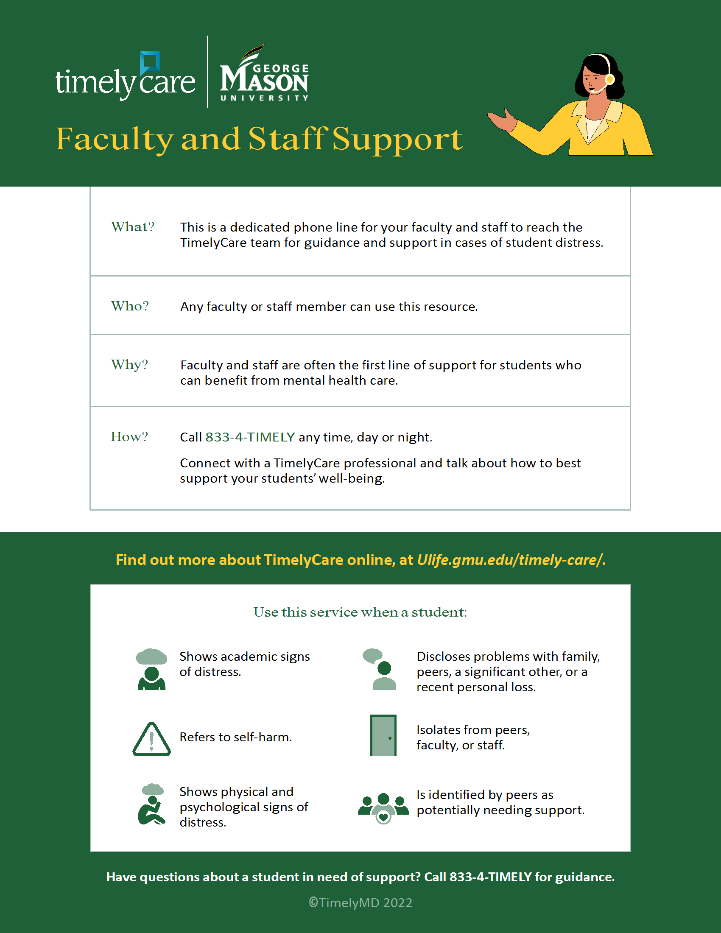

Slide 10
Questions?
24/7 SUPPORT: CALL 833-4-TIMELY
Abby Waldron
Client Success Manager
abby.waldron@timely.md
Michelle Ward
Client Success Associate
michelle.ward@timely.md
Rachel Wernicke, Ph.D.
Associate Dean and Chief Mental Health Officer
University Life
rwernick@gmu.edu

Slide 11
George Mason University
4400 University Drive Fairfax, Virginia 22030 Tel: (703) 993-1000
Learn More at GMU.EDU

